Slide 1
Euler’s Theorem
MD. SHAHADAT HOSSAIN
Email: shahadatmathku@gmail.com

Slide 2
Index
Homogeneous function
Euler’s Theorem on Homogeneous function
Problems related to Euler’s Theorem
Deduction from Euler’s Theorem
Problems related to Deduction from Euler’s Theorem
Exercise

Slide 3
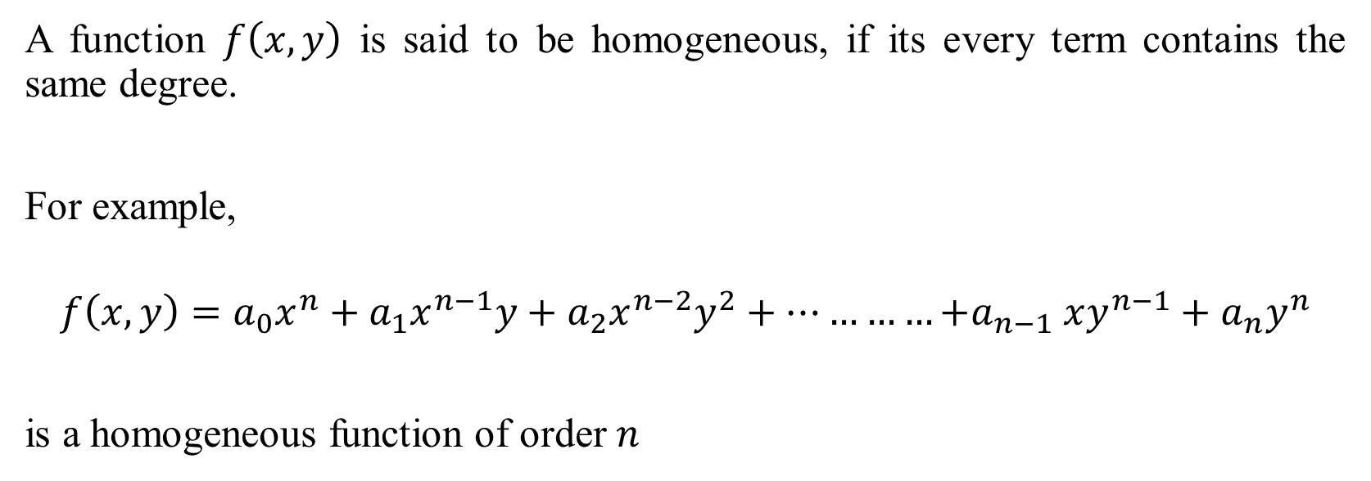
Homogeneous Function
A function $f\left(x,y\right)$ is said to be homogeneous, if its every term contains the same degree.
For example,
$$f\left(x,y\right)=a_{0}x^{n}+a_{1}x^{n−1}y+a_{2}x^{n−2}y^{2}+…………{+a}_{n−1}xy^{n−1}+a_{n}y^{n}$$
is a homogeneous function of order $n$

Slide 4
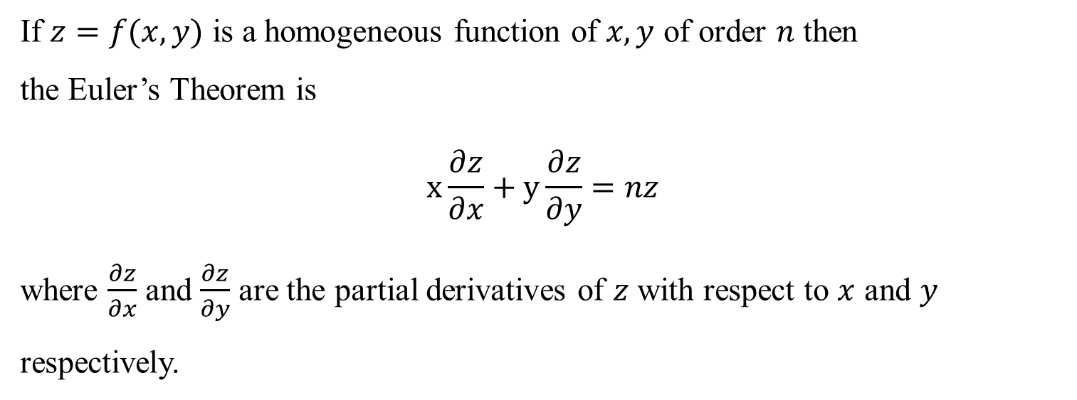
If $z=f(x,y)$ is a homogeneous function of $x,y$ of order $n$ then the Euler’s Theorem is $$x\frac{∂z}{∂x}+y\frac{∂z}{∂y}=nz$$ where $\frac{∂z}{∂x}$ and $\frac{∂z}{∂y}$ are the partial derivatives of $z$ with respect to $x$ and $y$ respectively.
Euler’s Theorem on homogeneous function

Slide 5
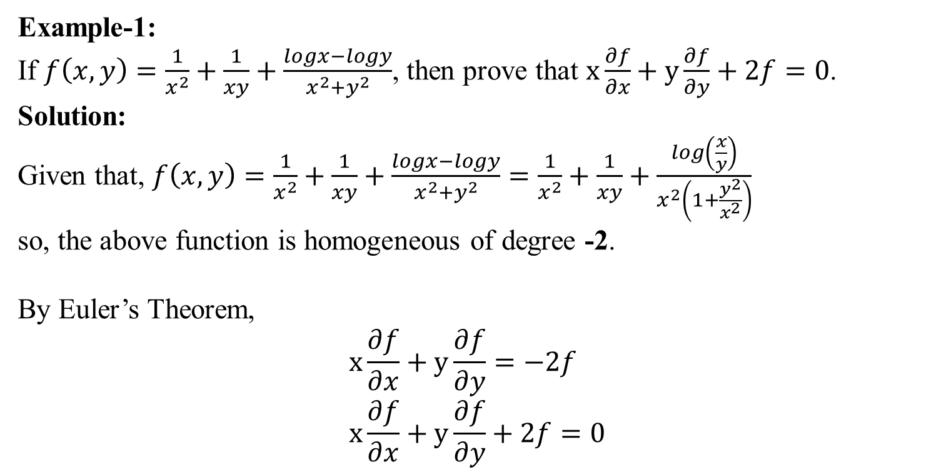
Example-1: If $f\left(x,y\right)=\frac{1}{x^{2}}+\frac{1}{xy}+\frac{logx−logy}{x^{2}+y^{2}}$, then prove that $x\frac{∂f}{∂x}+y\frac{∂f}{∂y}+2f=0$. Solution: Given that, $f\left(x,y\right)=\frac{1}{x^{2}}+\frac{1}{xy}+\frac{logx−logy}{x^{2}+y^{2}}=\frac{1}{x^{2}}+\frac{1}{xy}+\frac{log\left(\frac{x}{y}\right)}{x^{2}\left(1+\frac{y^{2}}{x^{2}}\right)}$ so, the above function is homogeneous of degree -2. By Euler’s Theorem, $$x\frac{∂f}{∂x}+y\frac{∂f}{∂y}=−2f \\ x\frac{∂f}{∂x}+y\frac{∂f}{∂y}+2f=0$$
Euler’s Theorem on homogeneous function
(Proved)

Slide 6
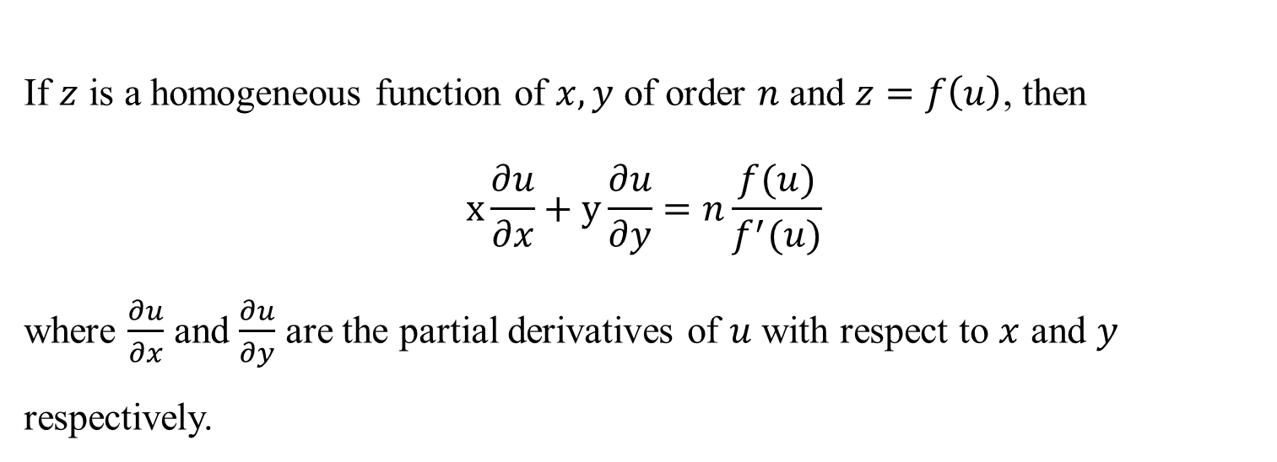
If $z$ is a homogeneous function of $x,y$ of order $n$ and $z=f\left(u\right)$, then $$x\frac{∂u}{∂x}+y\frac{∂u}{∂y}=n\frac{f(u)}{f^{′}(u)}$$ where $\frac{∂u}{∂x}$ and $\frac{∂u}{∂y}$ are the partial derivatives of $u$ with respect to $x$ and $y$ respectively.
Deduction from Euler’s Theorem

Slide 7
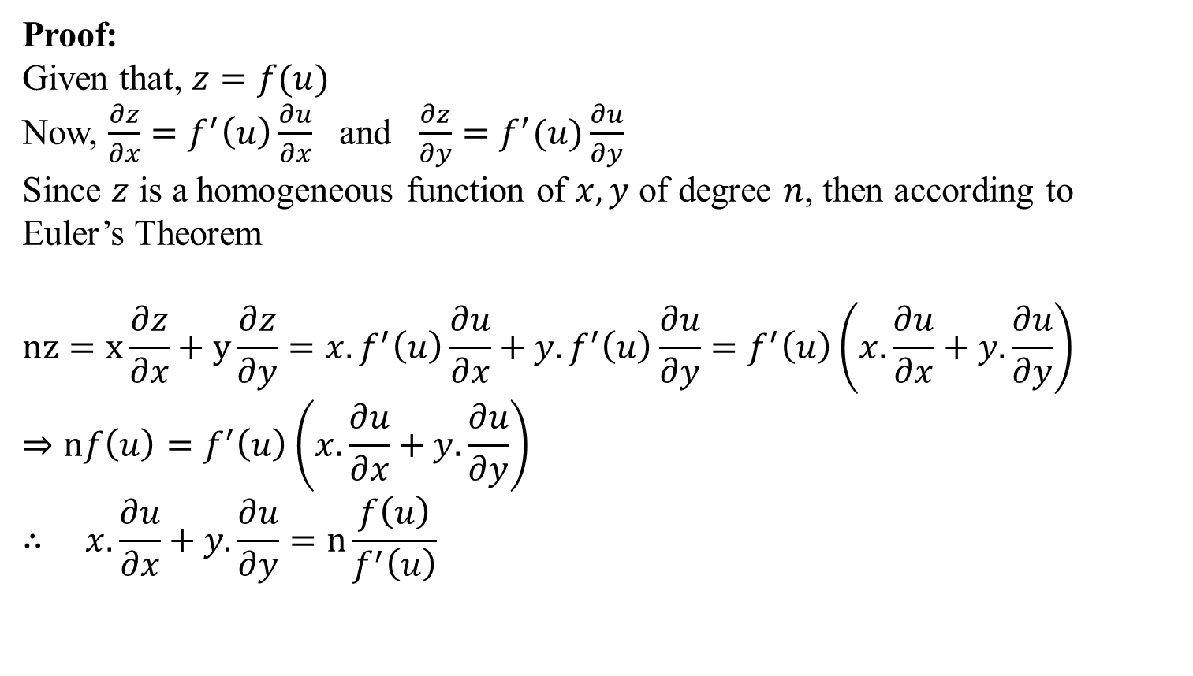
Proof: Given that, $z=f(u)$ Now, $\frac{∂z}{∂x}=f^{′}\left(u\right)\frac{∂u}{∂x}$ and $\frac{∂z}{∂y}=f^{′}(u)\frac{∂u}{∂y}$ Since $z$ is a homogeneous function of $x,y$ of degree $n$, then according to Euler’s Theorem $$nz=x\frac{∂z}{∂x}+y\frac{∂z}{∂y}={x.f}^{′}\left(u\right)\frac{∂u}{∂x}+{y.f}^{′}\left(u\right)\frac{∂u}{∂y}=f^{′}\left(u\right)\left(x.\frac{∂u}{∂x}+y.\frac{∂u}{∂y}\right) \\ ⇒nf\left(u\right)=f^{′}\left(u\right)\left(x.\frac{∂u}{∂x}+y.\frac{∂u}{∂y}\right) \\ ∴ x.\frac{∂u}{∂x}+y.\frac{∂u}{∂y}=n\frac{f\left(u\right)}{f^{′}\left(u\right)}$$
Deduction from Euler’s Theorem

Slide 8
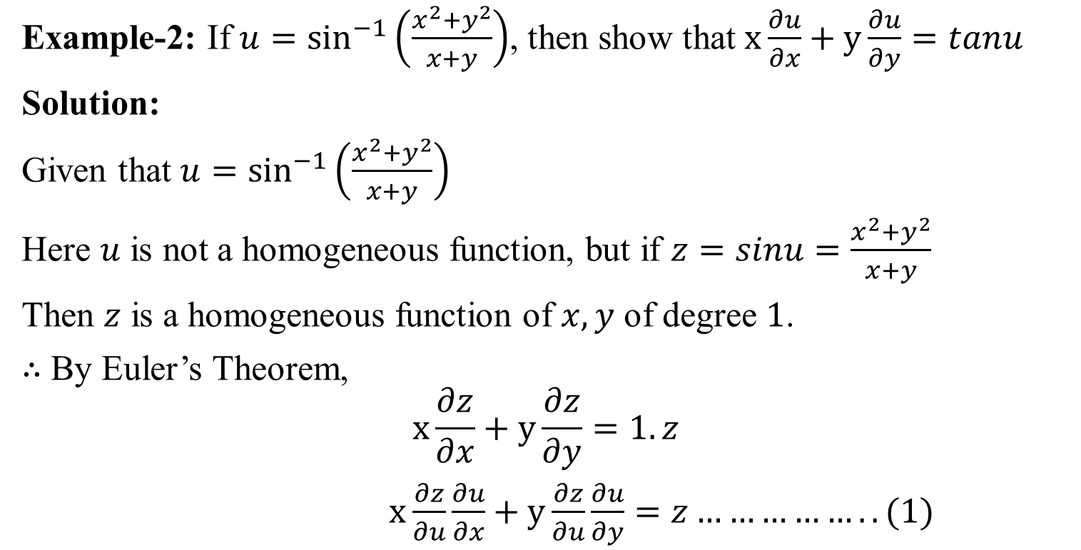
Example
Example-2: If $u=\sin^{−1}\left(\frac{x^{2}+y^{2}}{x+y}\right)$, then show that $x\frac{∂u}{∂x}+y\frac{∂u}{∂y}=tanu$
Solution:
Given that $u=\sin^{−1}\left(\frac{x^{2}+y^{2}}{x+y}\right)$
Here $u$ is not a homogeneous function, but if $z=sinu=\frac{x^{2}+y^{2}}{x+y}$
Then $z$ is a homogeneous function of $x,y$ of degree $1$.
$∴$ By Euler’s Theorem,
$$x\frac{∂z}{∂x}+y\frac{∂z}{∂y}=1.z$$
$x\frac{∂z}{∂u}\frac{∂u}{∂x}+y\frac{∂z}{∂u}\frac{∂u}{∂y}=z……………..(1)$

Slide 9

Putting the values $\frac{∂z}{∂u}=cosu$ and $z$ in (1), we get
$$x.cosu.\frac{∂u}{∂x}+y.cosu.\frac{∂u}{∂y}=sinu$$
$$⇒x\frac{∂u}{∂x}+y\frac{∂u}{∂y}=\frac{sinu}{cosu}$$
$$∴x\frac{∂u}{∂x}+y\frac{∂u}{∂y}=tanu$$

Slide 10
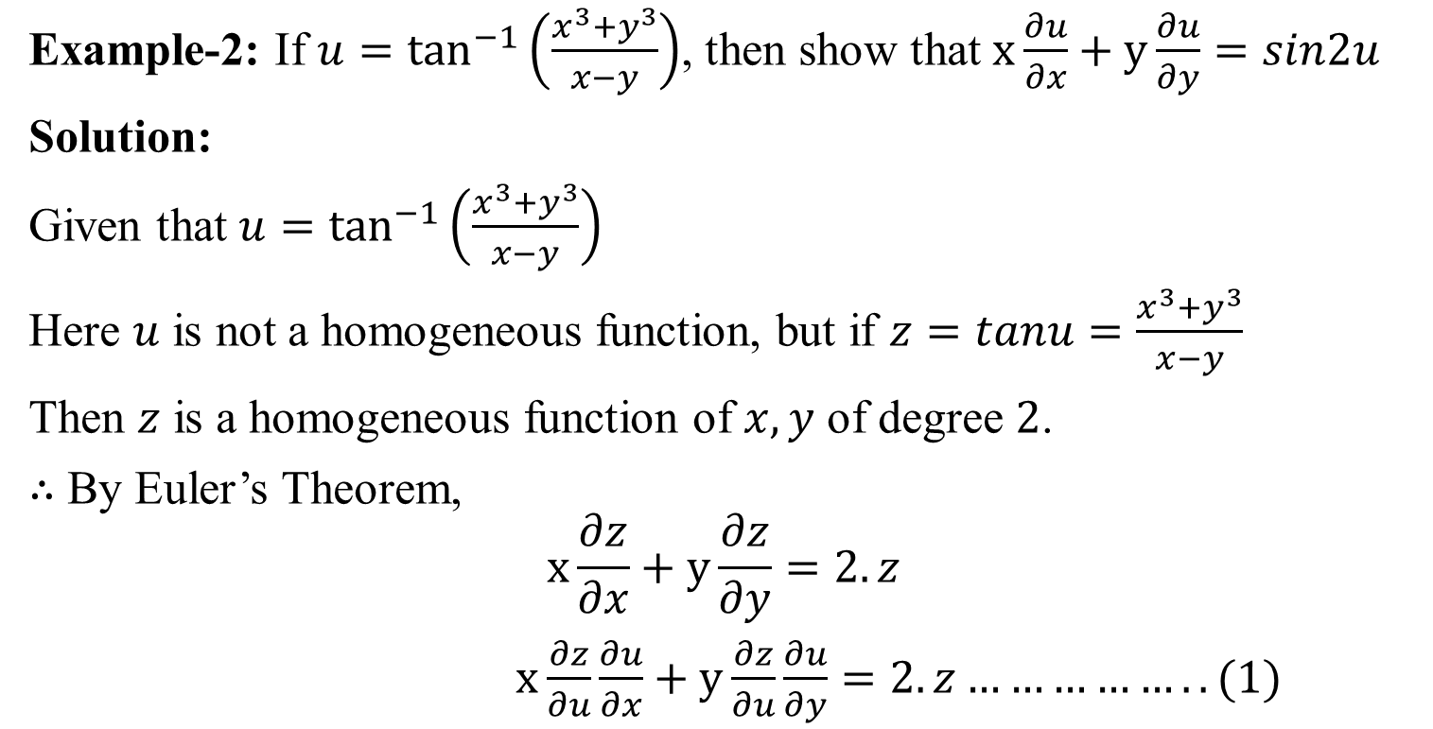
Example
Example-2: If $u=\tan^{−1}\left(\frac{x^{3}+y^{3}}{x−y}\right)$, then show that $x\frac{∂u}{∂x}+y\frac{∂u}{∂y}=sin2u$
Solution:
Given that $u=\tan^{−1}\left(\frac{x^{3}+y^{3}}{x−y}\right)$
Here $u$ is not a homogeneous function, but if $z=tanu=\frac{x^{3}+y^{3}}{x−y}$
Then $z$ is a homogeneous function of $x,y$ of degree $2$.
$∴$ By Euler’s Theorem,
$$x\frac{∂z}{∂x}+y\frac{∂z}{∂y}=2.z$$
$x\frac{∂z}{∂u}\frac{∂u}{∂x}+y\frac{∂z}{∂u}\frac{∂u}{∂y}=2.z……………..(1)$

Slide 11
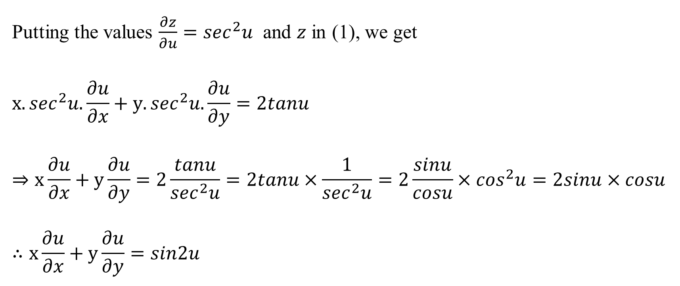
Putting the values $\frac{∂z}{∂u}=\sec^{2}u$ and $z$ in (1), we get
$$x.\sec^{2}u.\frac{∂u}{∂x}+y.\sec^{2}u.\frac{∂u}{∂y}=2tanu$$
$$⇒x\frac{∂u}{∂x}+y\frac{∂u}{∂y}=2\frac{tanu}{\sec^{2}u}=2tanu×\frac{1}{\sec^{2}u}=2\frac{sinu}{cosu}×\cos^{2}u=2sinu×cosu$$
$$∴x\frac{∂u}{∂x}+y\frac{∂u}{∂y}=sin2u$$

Slide 12

Exercise:
Verify the Euler’s Theorem of the following functions
$u=\sin^{−1}{\frac{x}{y}}+\tan^{−1}{\frac{y}{x}}$
$u=\log_{e}\left(\frac{x^{4}+y^{4}}{x+y}\right)$
$u=\tan^{−1}\left(\frac{x^{3}+y^{3}}{x−y}\right)$

Slide 13
STAY HOME
&
BE SAFE

Slide 14
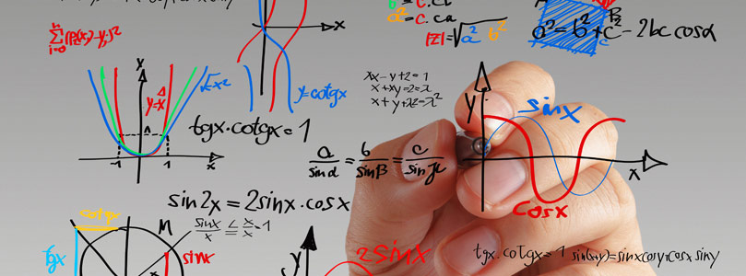
“Equations are much more important to me, because politics is for the present, while an equation is for eternity.”
— Albert Einstein

